Slide 1
PEER LEADERS
@SDSU

Slide 2


Topics to discuss
Conversation starter: Overview of Field
  SDSU Model
  Putting CSU programs in context
Mary: ULAs in College Algebra
Janet: Lab Leaders in PreCalculus

Slide 3
What to call these student helpers??
Peer Leaders
Peer Leaders
ULA/ LA
Undergrad Learning Assistant
SI
Supplemental Instruction Leader
TA
(Undergrad) Teaching Assistant
ISA
Instructional Student Assistant

Slide 4


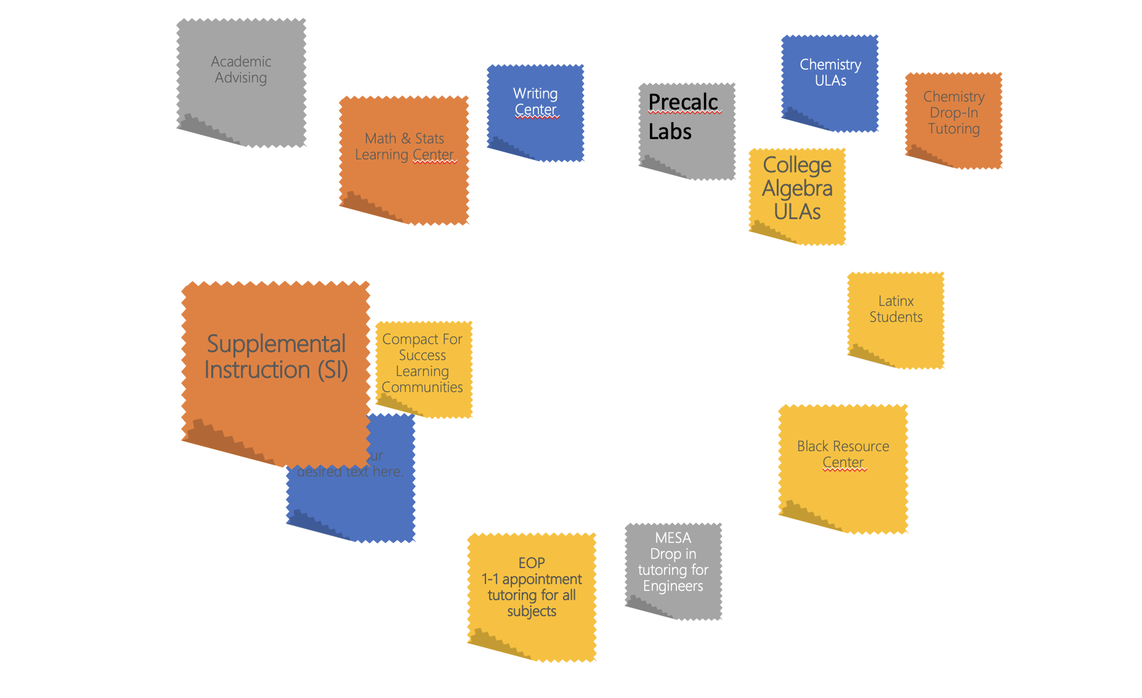




Overarching Learning Commons
Tutoring Center Model
Decentralized
Tutoring Center Model
Drop in Tutoring
Department-specific peer Tutors
Other Identity or Major Programs
SI Programs
1-1 Tutoring
Other Academic Programs

Slide 5
Undergraduate Peer Leaders at SDU
Mary will discuss
Academic Advising
Chemistry
ULAs
Writing Center
Precalc
Labs
Chemistry Drop-In Tutoring
Math & Stats Learning Center
College Algebra ULAs
Department
Level
Academic
Affairs
Supplemental Instruction (SI)
Managed via ITS
Latinx Students
Compact For Success Learning Communities
Student
Services
Identity
Centers
National
Orgs
Black Resource Center
Dorm Tutors
MESA
Drop in tutoring for Engineers
Janet will discuss
EOP
1-1 appointment tutoring for all subjects

Slide 6
Big Picture:
Peer Instruction
HIGH INSTRUCTOR COLLABORATION
Embedded Peers
SDSU
ULAs
Graders
CSU Fullerton
Math Apprentice Program
TEST proctors
CSU East Bay LA program
CSUCI: Embedded Peer Ed
HSU Embedded Tutors
SDSU
LAB LEADERS
LOOSE LINK
TO CLASS
TIGHT LINK
TO CLASS
SFSU
LA program
HSU SI embedded tutors
Sonoma State
Stretched Math
Learning Communities
Tutors in centers
SFSU SI LEADERS
SI Programs
The Big Picture
HIGH LEAD AUTONOMY
Notes:
Cherie Ichinose introduced the Titan Math Apprentice Program that places math majors as apprentices with math faculty
Loriann Negri & Cora Orme talked about Sonoma State’s Stretched Math Learning Communities that are like SI (peer led, focus on active learning), but attendance is mandatory.
Kim Coble talked about SFSU LA program, housed under our Center for Science and Math Education (CSME), began in 2017 in physics, astronomy, and chemistry and plans to expand to math and computer science in Fall 2021. Our LAs typically serve in large introductory “lecture” courses (45-150 students), helping facilitate active learning.
Jessica Fielder talked about SFSU’s SI program is supported by the College of Science and Engineering and Center for Science and Math Education and provides small, peer-led team learning environments to students in historically challenging courses.
Julie Glass, Joshua Kerr and Alicia Still talked about CSU East Bay’s Embedded peer support program that has Las serving in two capacities: 1) supporting active learning in the classroom and 2) working as a tutor in the math lab

Slide 7
Big Picture:
Funding & Training
Academic Department $
SDSU
LAB LEADERS
SDSU
ULAs
HSU Embedded Tutors
CSU Fullerton
Math Apprentice Program
CSUCI: Embedded Peer Ed
Domingez Hills
Required
Pedagogy
Class
Just In Time
Instruction
SFSU
LA program
SFSU SI LEADERS
Sonoma State
Stretched Math
Learning Communities
HSU SI
SAC State
The Big Picture
Student Services $ / Private Donations/Grant Based
Notes:
Cherie Ichinose introduced the Titan Math Apprentice Program that places math majors as apprentices with math faculty
Loriann Negri & Cora Orme talked about Sonoma State’s Stretched Math Learning Communities that are like SI (peer led, focus on active learning), but attendance is mandatory.
Kim Coble talked about SFSU LA program, housed under our Center for Science and Math Education (CSME), began in 2017 in physics, astronomy, and chemistry and plans to expand to math and computer science in Fall 2021. Our LAs typically serve in large introductory “lecture” courses (45-150 students), helping facilitate active learning.
Jessica Fielder talked about SFSU’s SI program is supported by the College of Science and Engineering and Center for Science and Math Education and provides small, peer-led team learning environments to students in historically challenging courses.
Julie Glass, Joshua Kerr and Alicia Still talked about CSU East Bay’s Embedded peer support program that has Las serving in two capacities: 1) supporting active learning in the classroom and 2) working as a tutor in the math lab

Slide 8
Fall 2018
7 sections
~80 enrollment cap
No ULAs
ULAs in College Algebra
Fall 2019
1 section
~56 students
2 ULAs
Fall 2019
5 sections (80 cap)
1 section (44 cap)
No ULAs
Needed to enhance student engagement!
Fall 2020 – COVID-19
8 sections
~50 enrollment cap
1 ULA per section
Spring 2021 – COVID-19
5 sections
~45 enrollment cap
2 ULAs per section
Notes:
https://unsplash.com/photos/m_HRfLhgABo
https://unsplash.com/photos/KE0nC8-58MQ
https://unsplash.com/photos/IyaNci0CyRk
https://unsplash.com/photos/ukOCJ09jpgc
Averages:
Fall 2018: C avg
Fall 2019: B/B- avg in ULA sec; C+ avg in non-ULA sec
Fall 2020: B-/C+ avg

Slide 9
What we are doing with ULAs:
  More group work!
    Activities
    Quizzes
  ULAs are in the tutoring center!
  ULAs help give feedback to students
  Instructors enjoy having ULAs
Where we need to grow:
  PD for instructors
  Enhance group activities
  Collect and analyze data!
ULAs in College Algebra
Needed to enhance student engagement!
More group work
Building relationships
Notes:
https://unsplash.com/photos/m_HRfLhgABo
https://unsplash.com/photos/KE0nC8-58MQ
https://unsplash.com/photos/IyaNci0CyRk
https://unsplash.com/photos/ukOCJ09jpgc
Fall 2019: 1sec=56, 1sec=39, 5 sections ~52-72

Slide 10
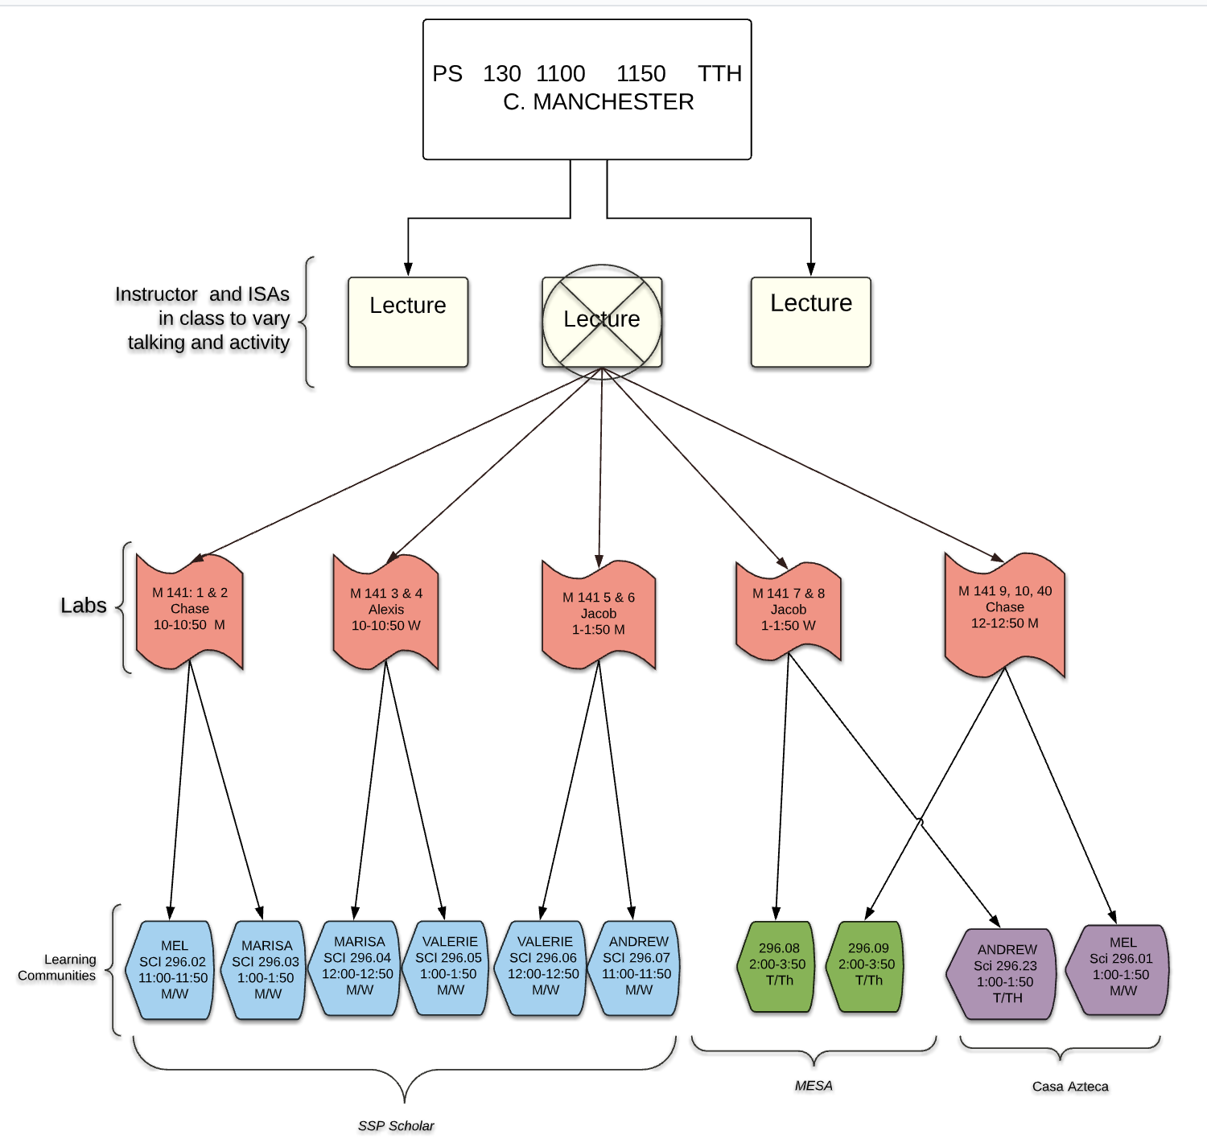

Starting in Fall, 2015
Lab Leaders in PreCalculus
Needed to provide more time for active learning.
Break out Labs (Lab Leaders)
Learning Communities (SI)
Notes:
https://unsplash.com/photos/m_HRfLhgABo
https://unsplash.com/photos/KE0nC8-58MQ
https://unsplash.com/photos/IyaNci0CyRk
https://unsplash.com/photos/ukOCJ09jpgc

Slide 11
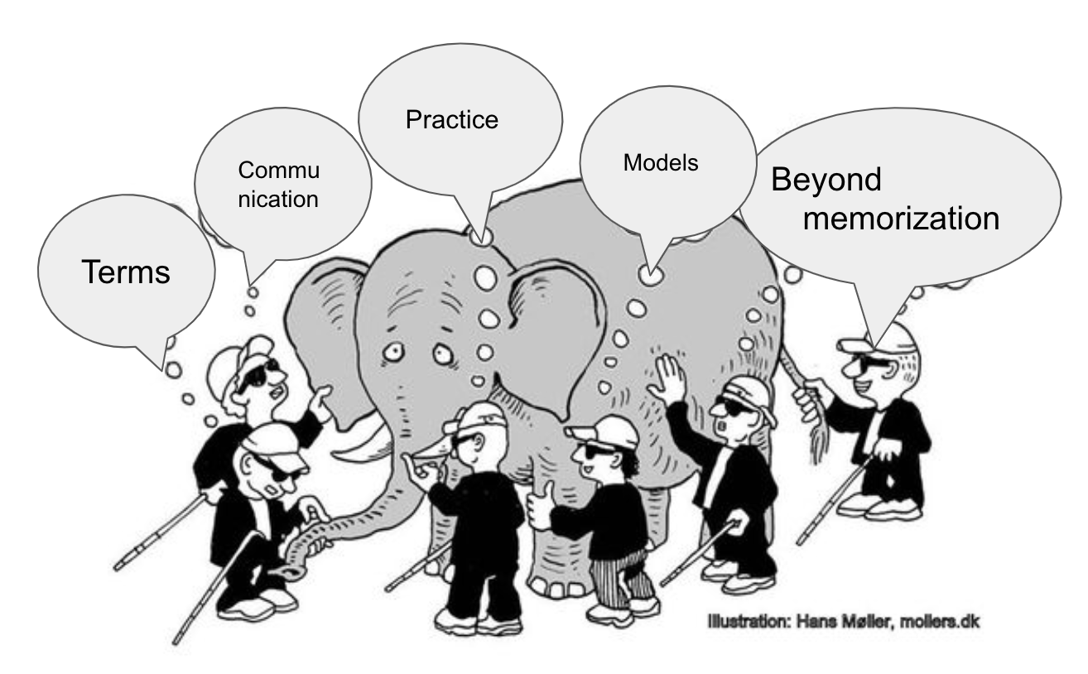
Goal of the Labs
Discussion
Data Modeling
Alternate Perspectives
Math Practice #4-5
Using data collection to model real-world phenomena (usually using Technology)
Math Practice #3:
Discuss ideas and critique the reasoning of others.
See phenomena in different ways

Slide 12
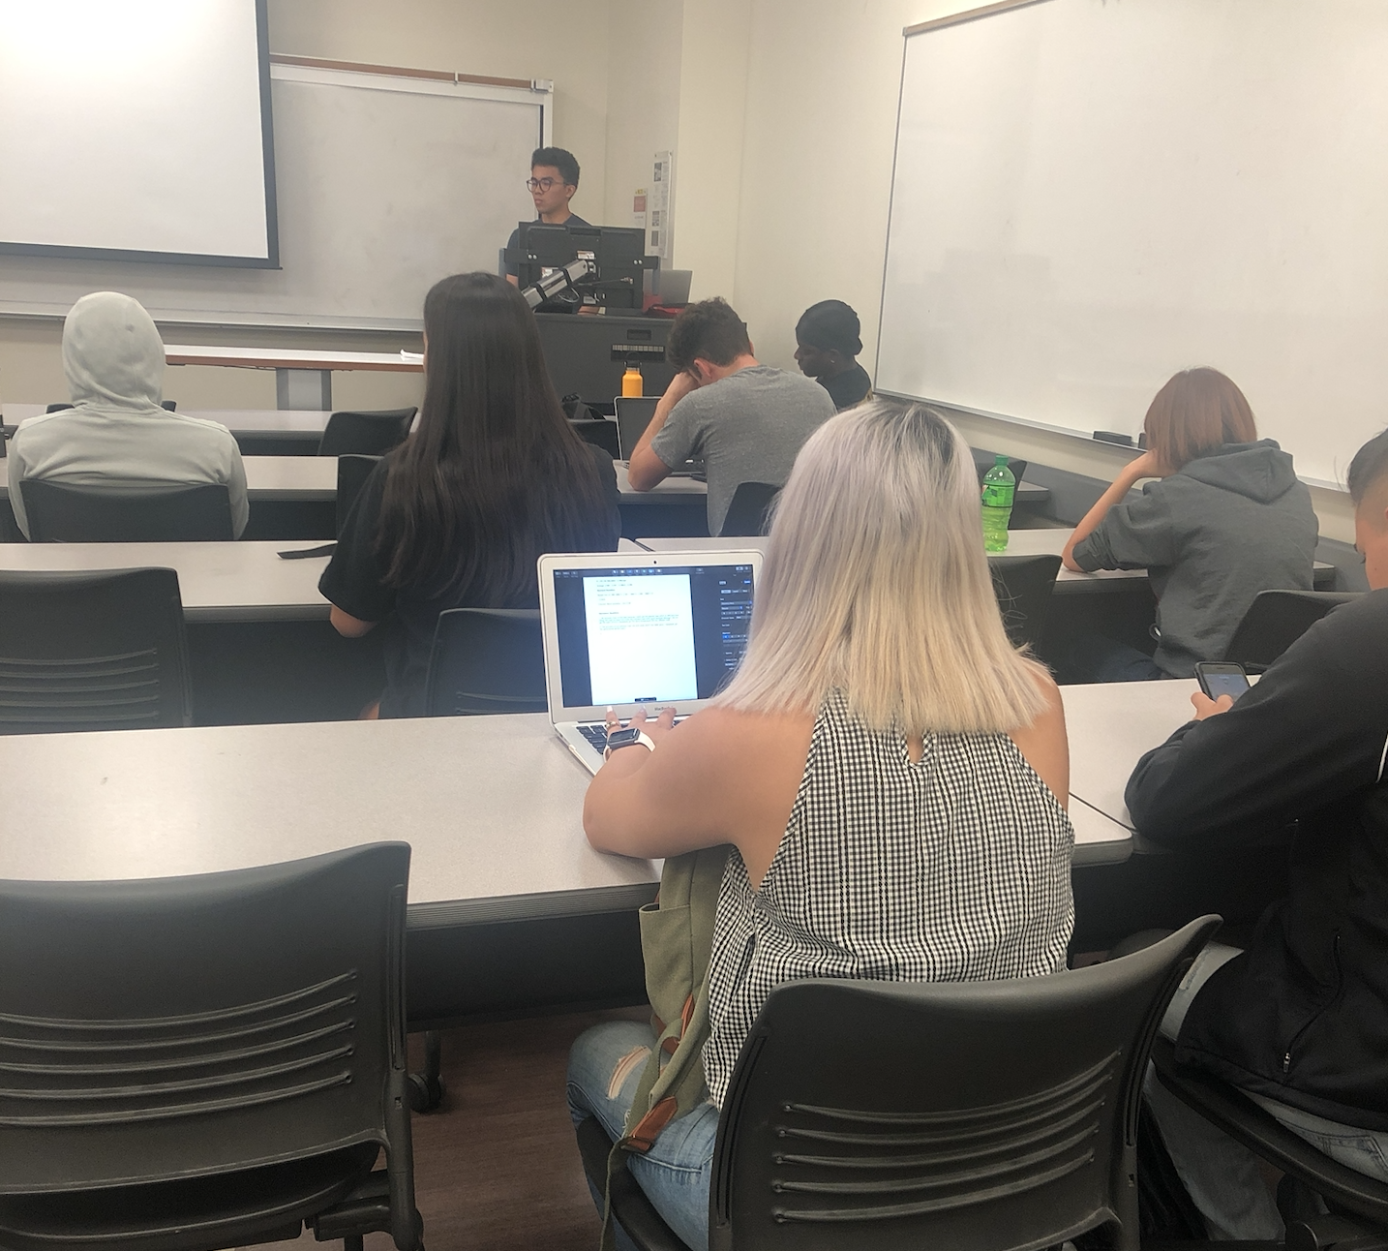
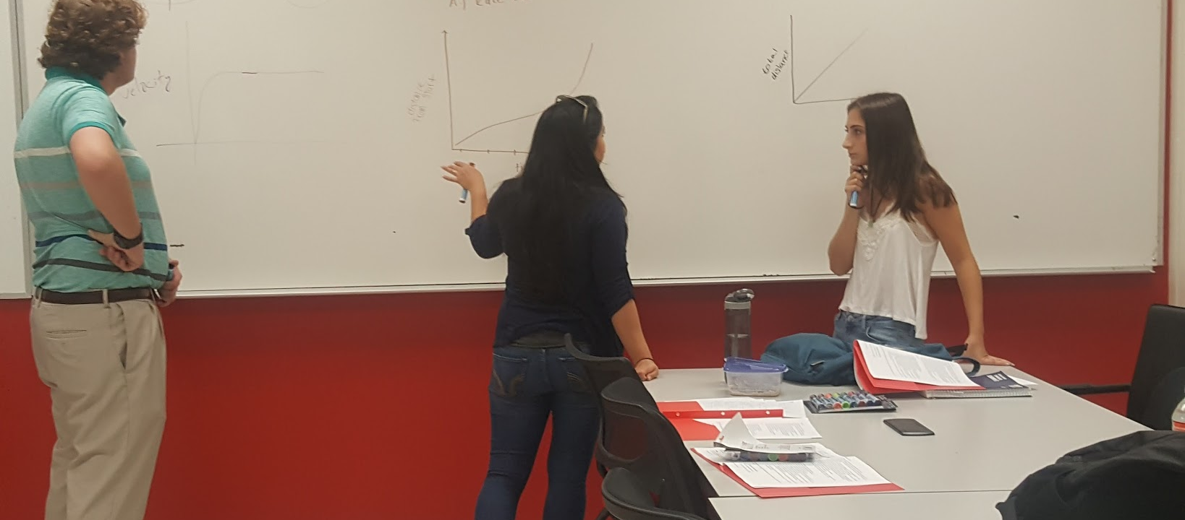
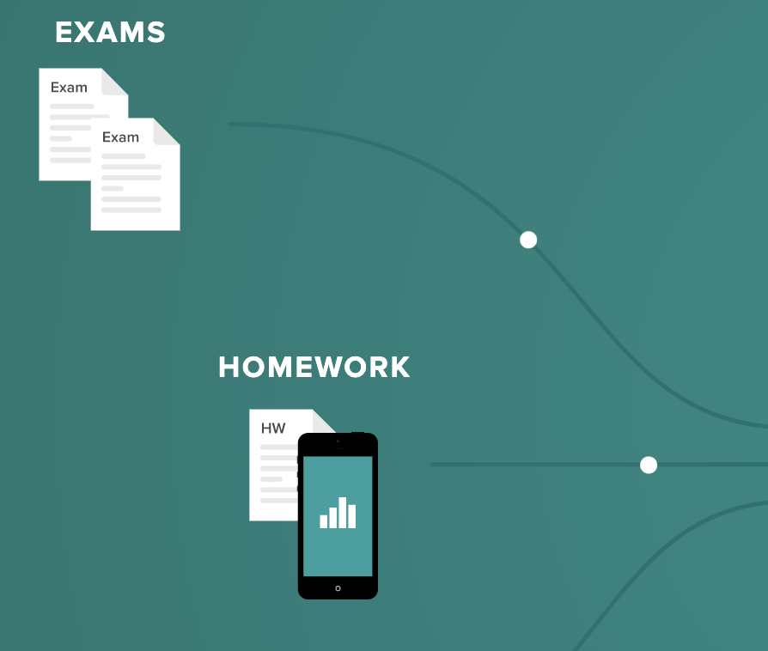
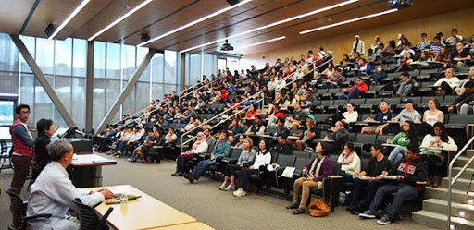
Responsibilities of Lab Leaders
Teaching Break out Labs
Each leader is assigned 2 labs/week (~ 25 students/lab)
Planning Sessions
Attend weekly planning meetings, observe other labs
Attending/Facilitating Lectures
Help with active learning and quick activities in lectures. (Also serve as role models for Ss)
Grading/Proctoring
Grade tests anonymously through Gradescope
A Peek Inside
Notes:
https://unsplash.com/photos/QL7KdXdcfWA
https://unsplash.com/photos/EOCJgBY8i7w
https://unsplash.com/photos/iusJ25iYu1c
https://unsplash.com/photos/3-Tc_5LROrM

Slide 13
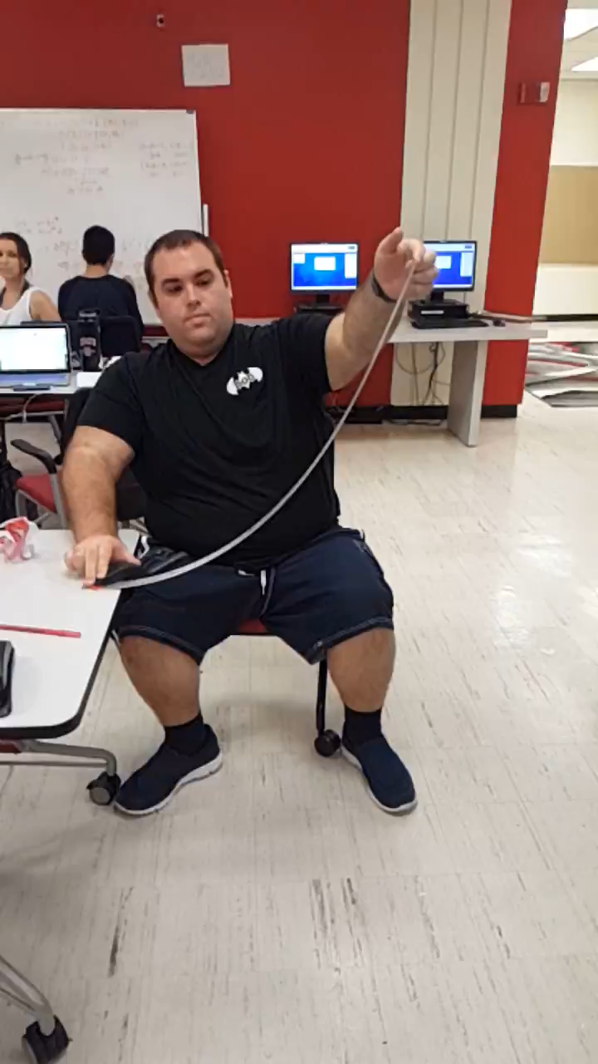
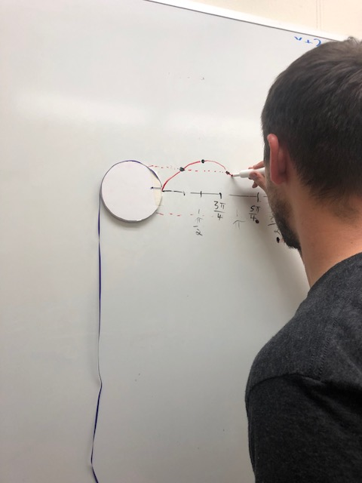
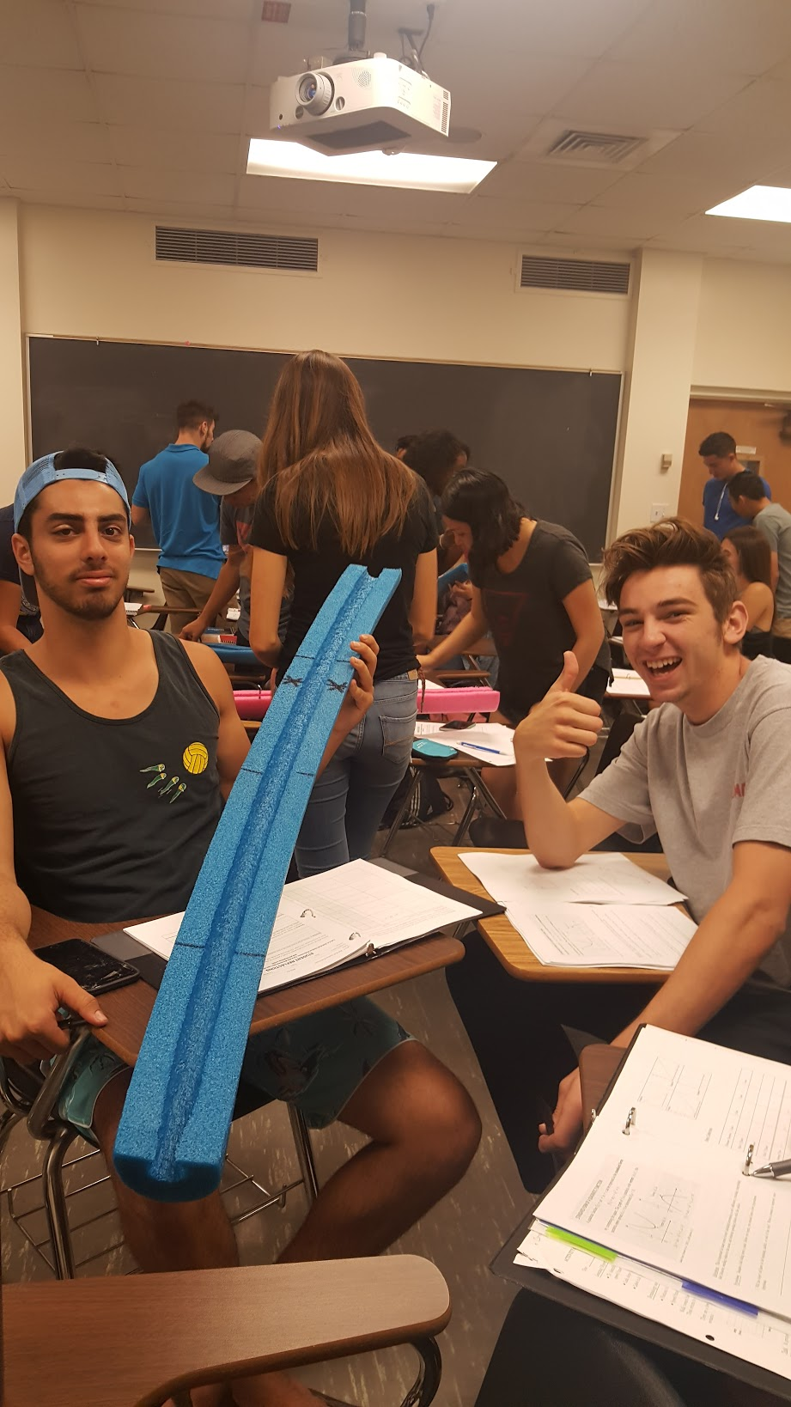
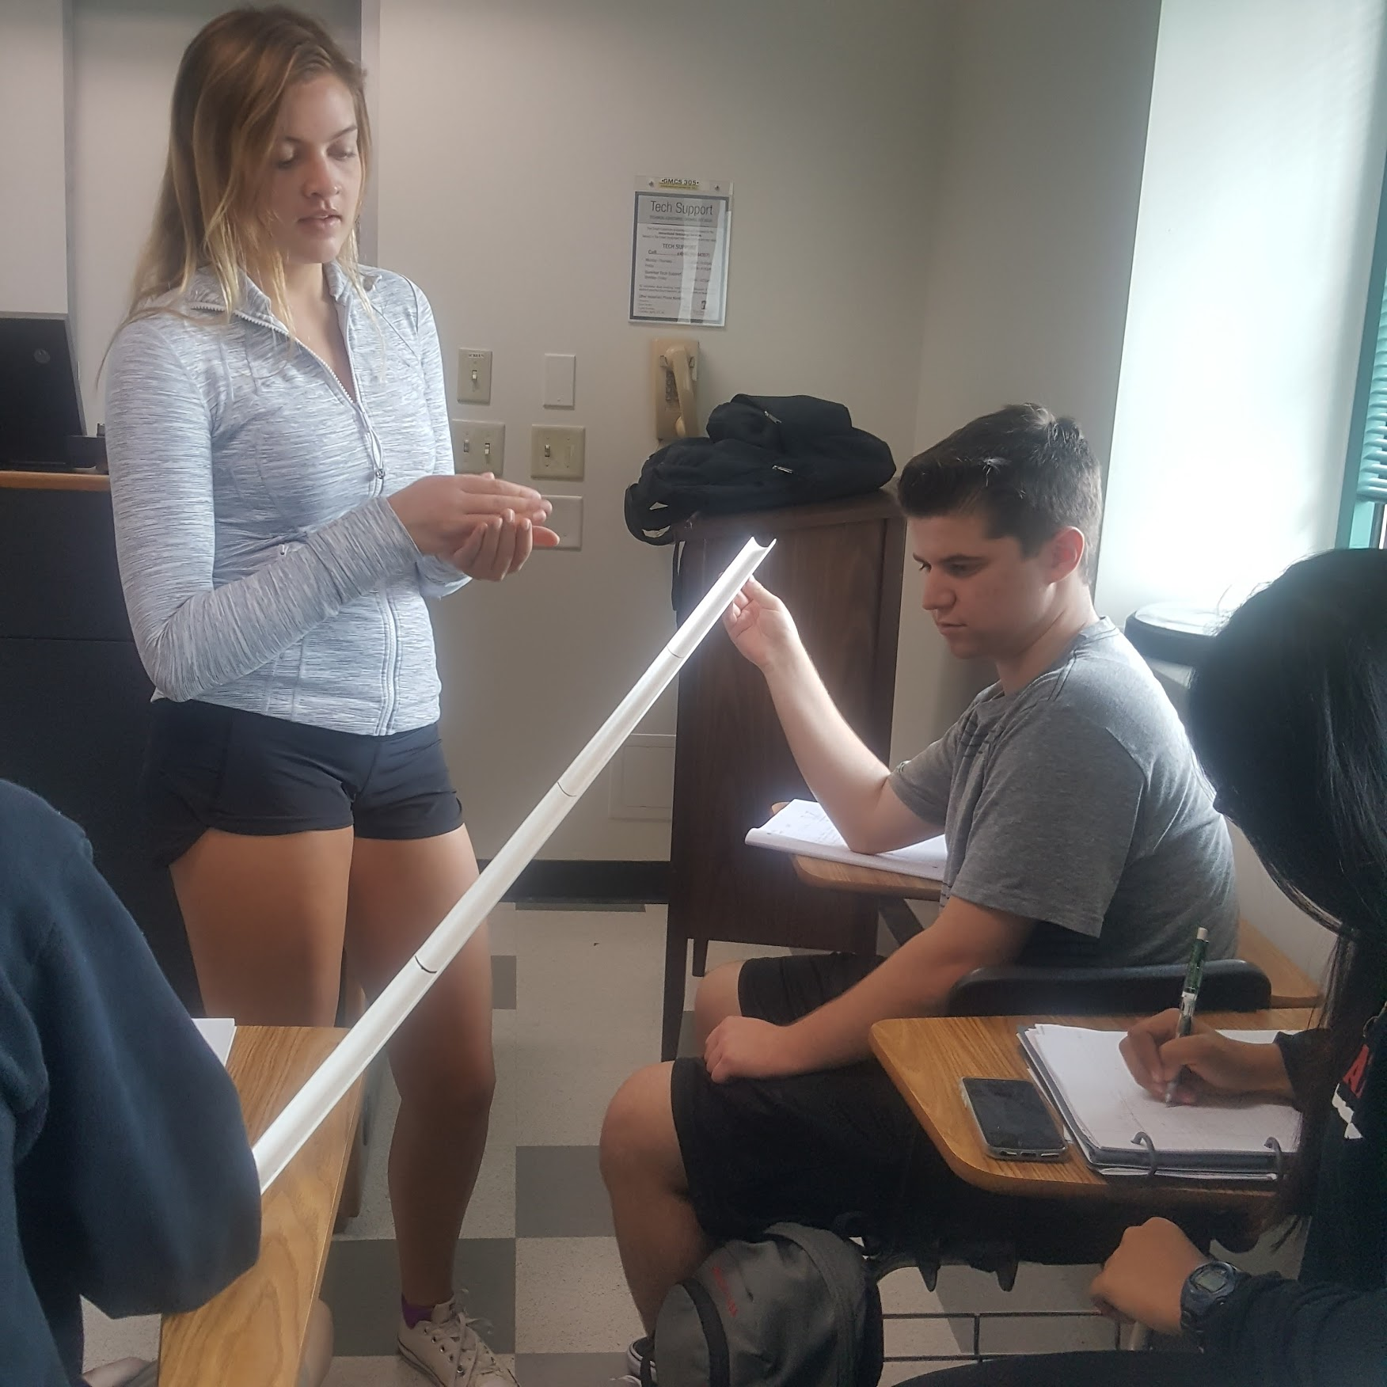
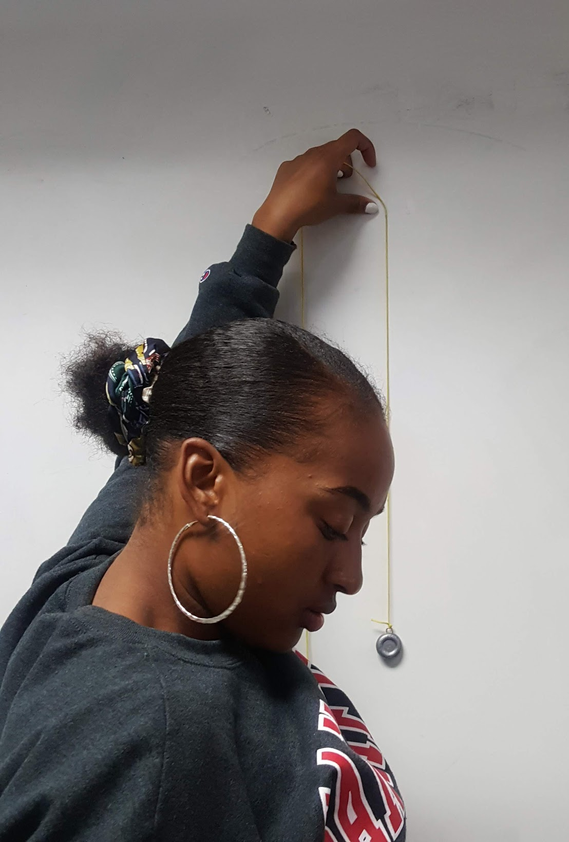
Active Learning Labs
Harmonic Motion
Sine Tracer
Ball Roll #1
Pendulum Tracer
Ball Roll #2

Slide 14
Q1: Students’ views of break out sessions:
There is a large increase in students’ views of the need for labs (most likely due to COVID); but once is enough! Some students wanted more asynchronous instruction, less Zoom time.
When pressed, students would prefer to drop modeling because they feel the tests are most important.

Slide 15
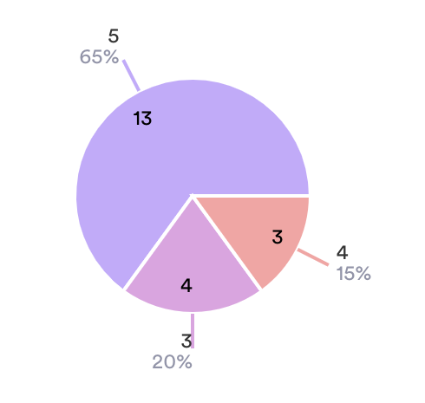
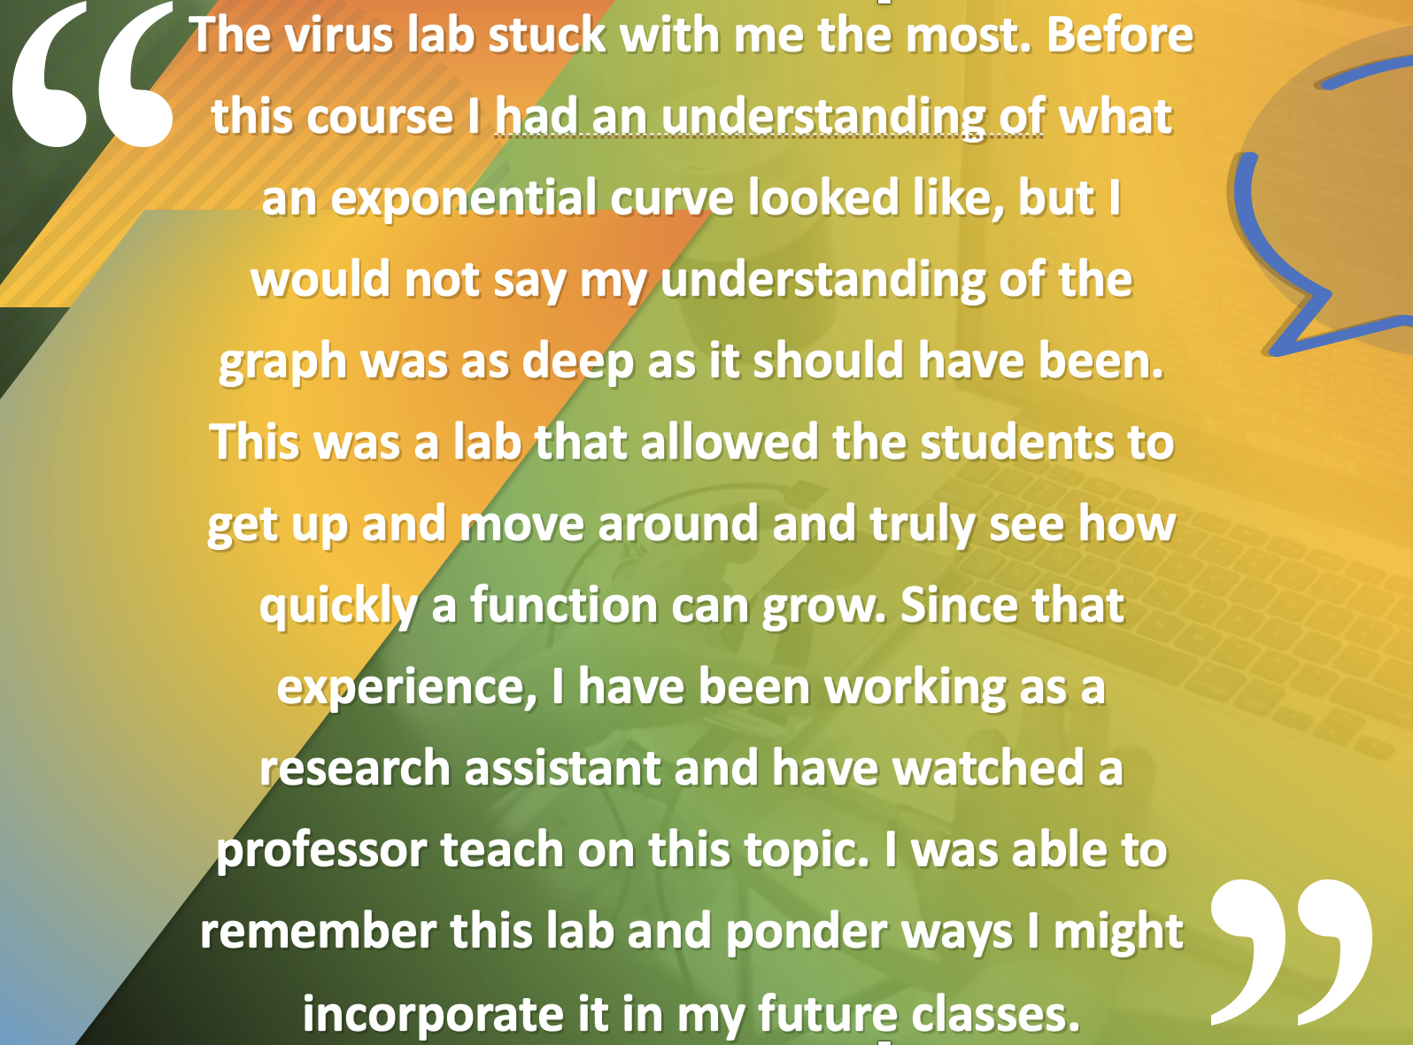
Math Understanding/Content
Strongly Agree
Agree
Neutral

Slide 16
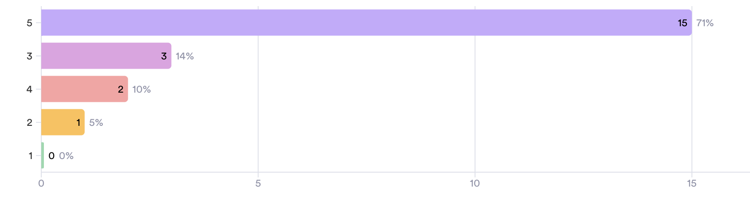
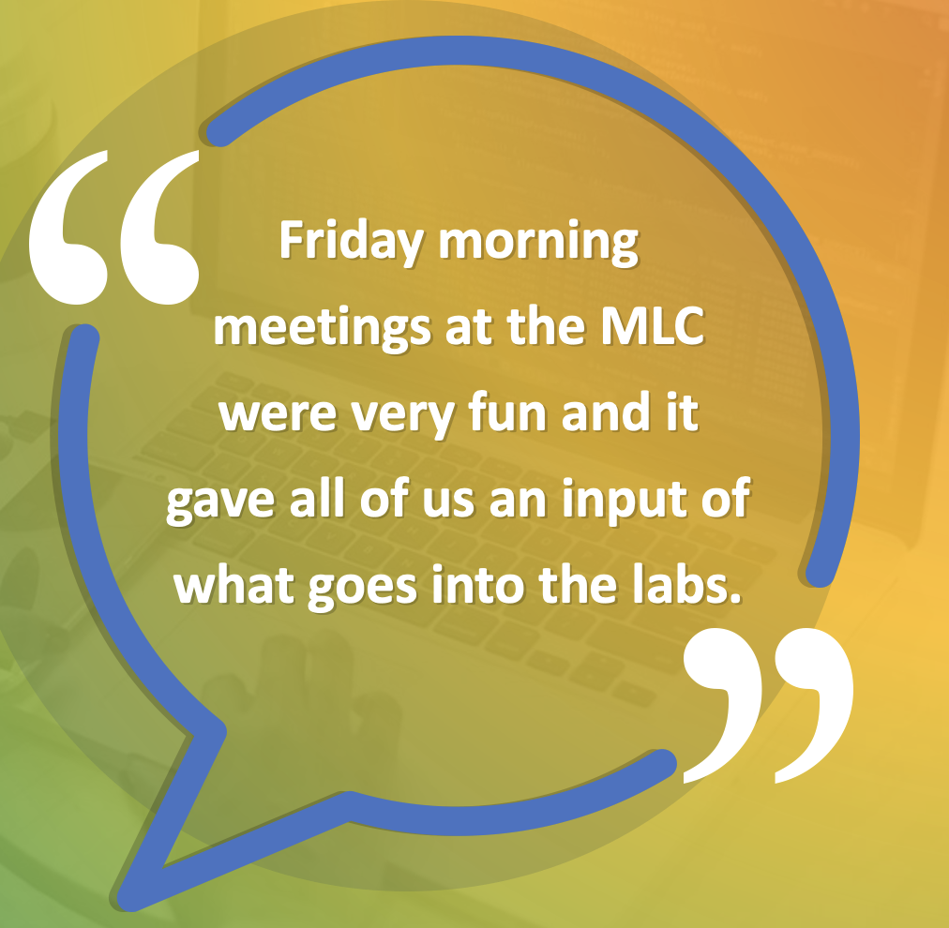
Feeling part of a community
Strongly Agree
Agree
Neutral
Disagree
Strongly Disagree

Slide 17
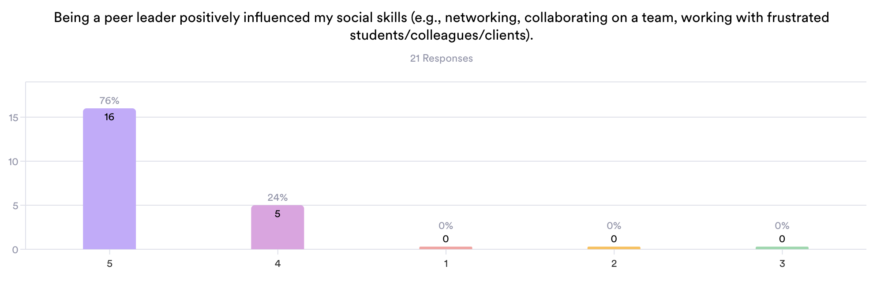
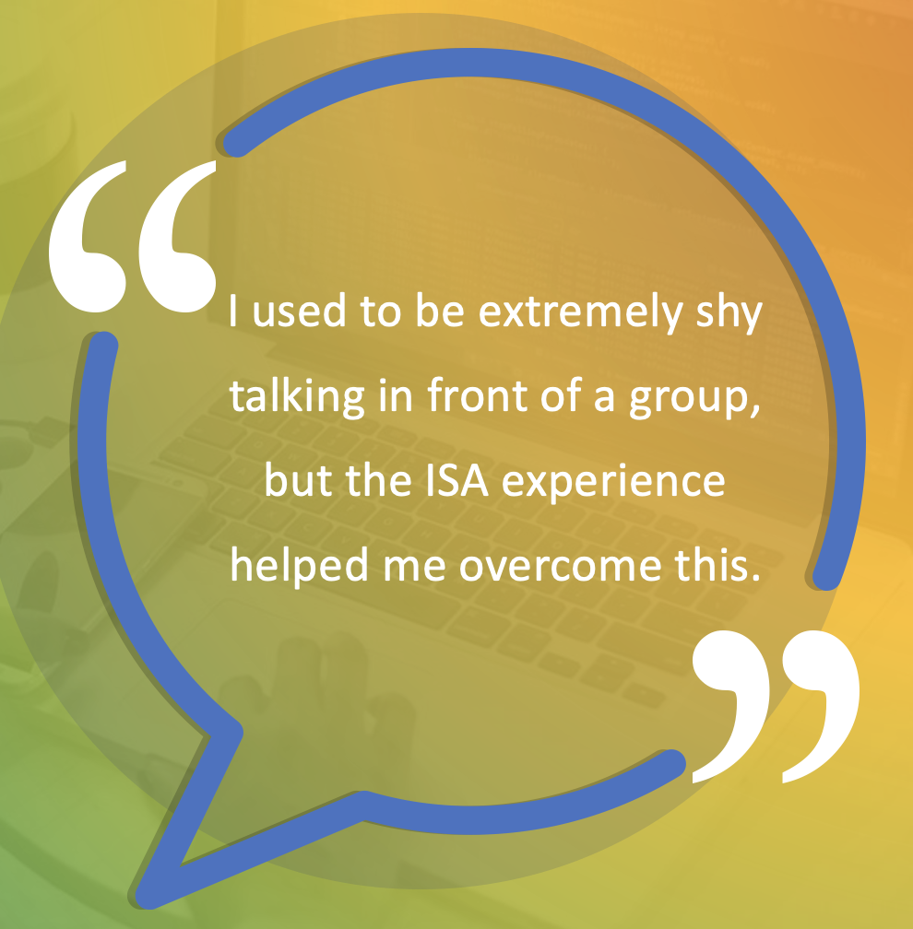
Social Skills
Strongly
Agree
Agree
Neutral
Disagree
Strongly
Disagree

Slide 18
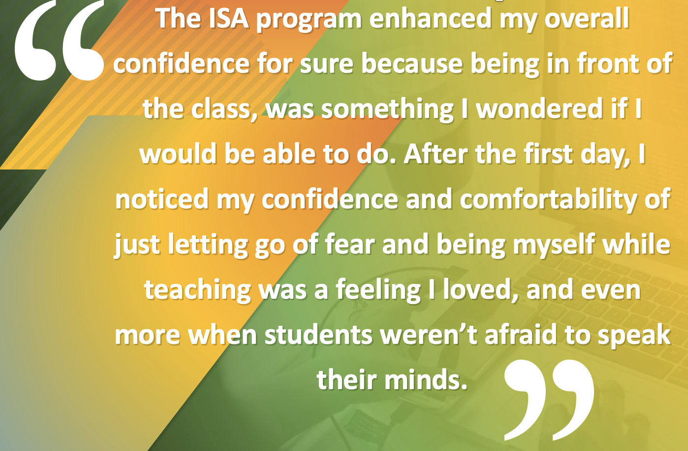
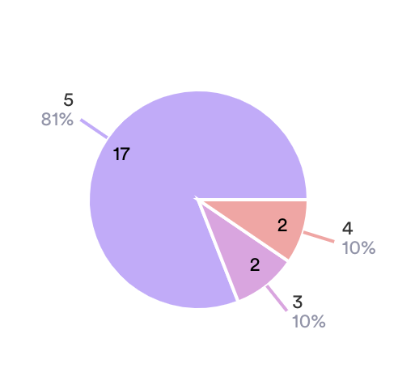
Overall Confidence
Strongly
Agree
Agree
Neutral

Slide 19
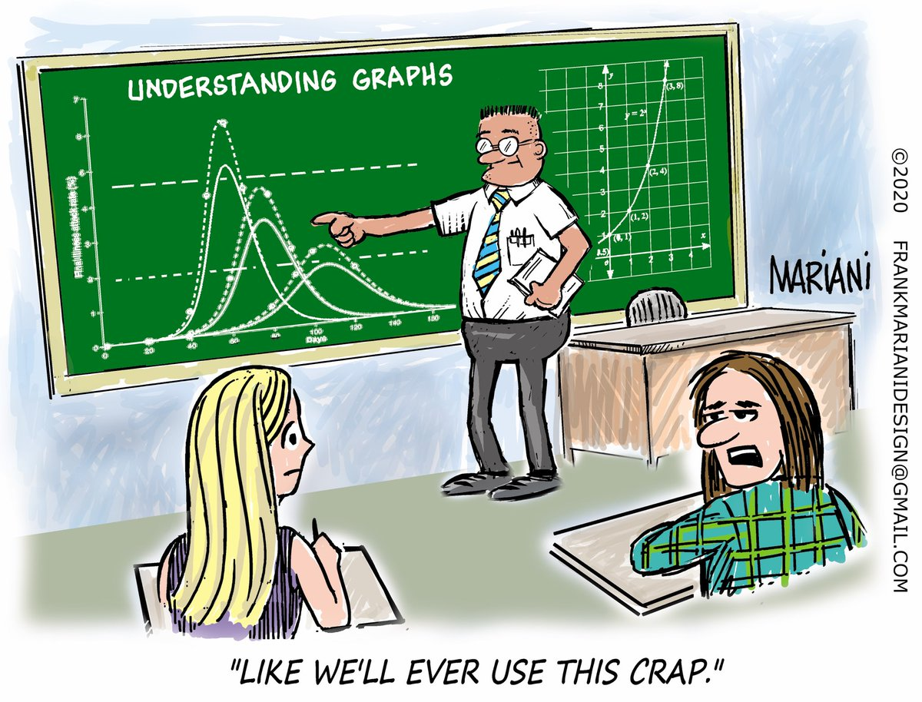
“The log applications still help me! Grasping how to deal with extremely small or large numbers is so essential.”
Labs and everyday life applications!??

Slide 20
Summary
Peer Leader Befits
Faculty Benefits
University Benefits
Students Benefit
Improved confidence
Improved content
knowledge
Improved view of
teaching
Improved feeling of
belonging (Julie @ EB)
Improved communication
skills
Liaison/Advocate
New explanation
Role Model
Feedback from leaders
(Abigail @ SacState)
Help with instruction
Enhanced
instruction
Cheap labor

Slide 21
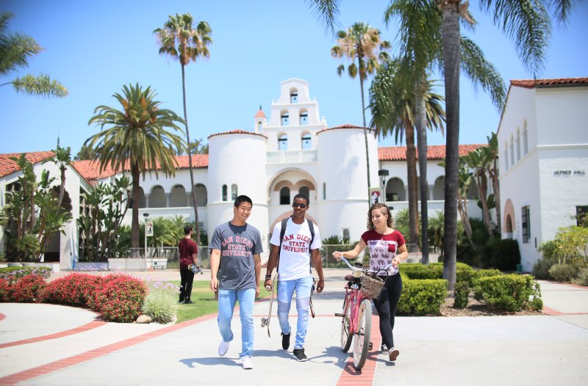
Mary Pilgrim
MPilgrim@SDSU.edu
Janet Bowers
JBowers@SDSU.edu
Notes:
https://unsplash.com/photos/jIUYon6MTnQ

